Slide 1
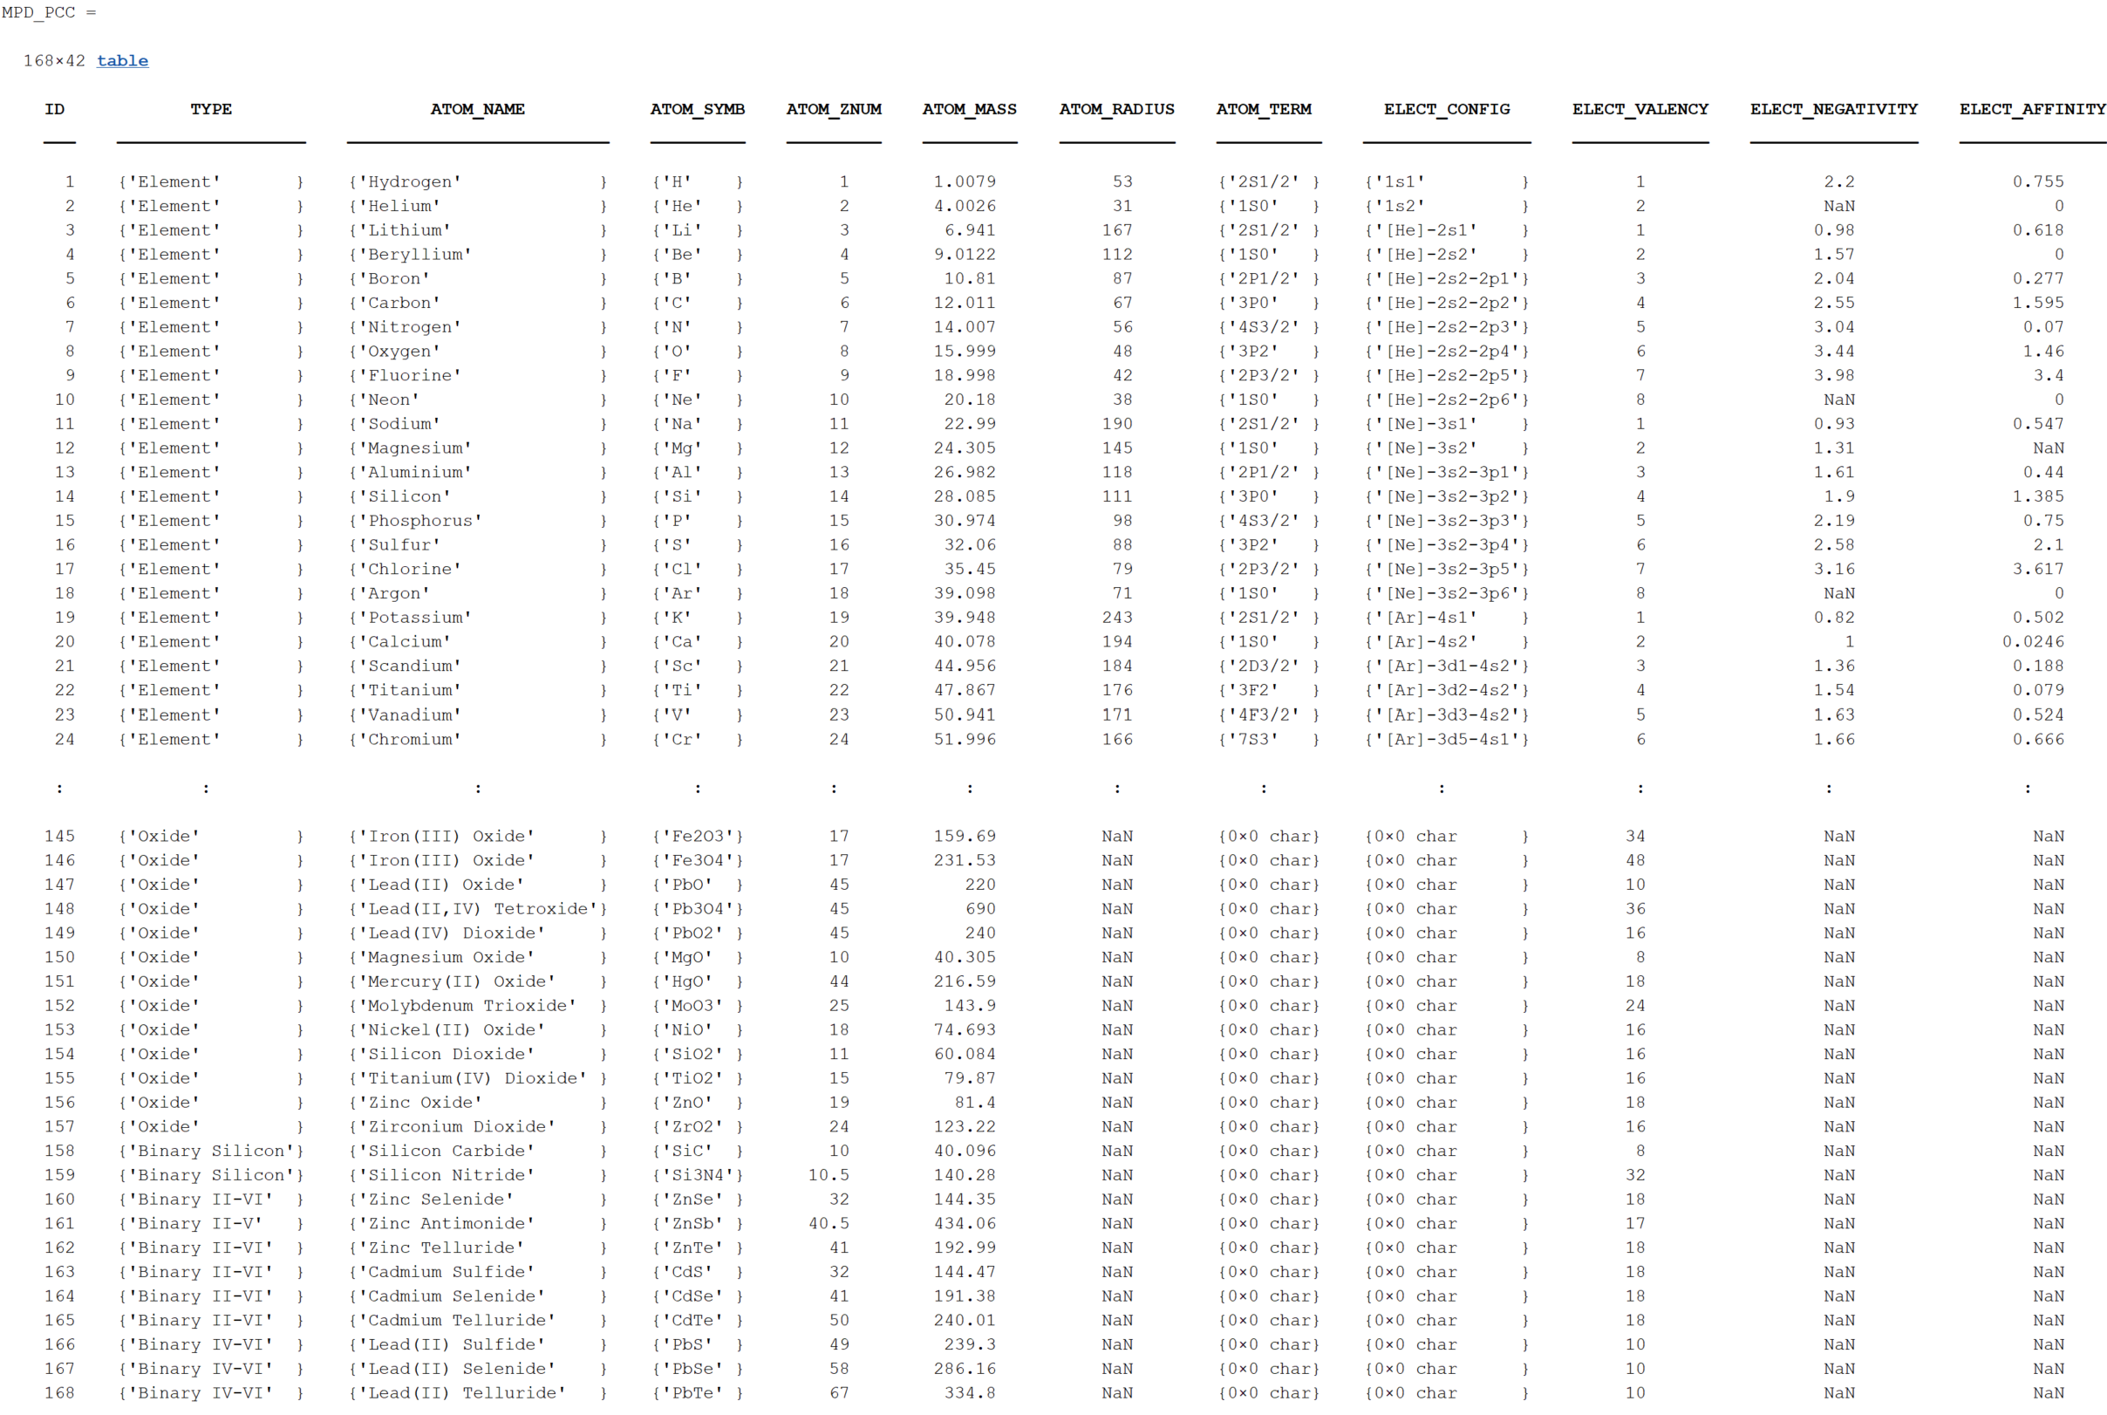
Showcase of the Materials Properties Database
Currently 168 material entries with 42 properties each:
Database saved in ‘MPD_PCC.mat’ MATLAB file.
Elements, Oxides, Binary Semiconductors, Ionic Salts.
Use ‘get_mpd_props()’ to extract material properties.

Slide 2
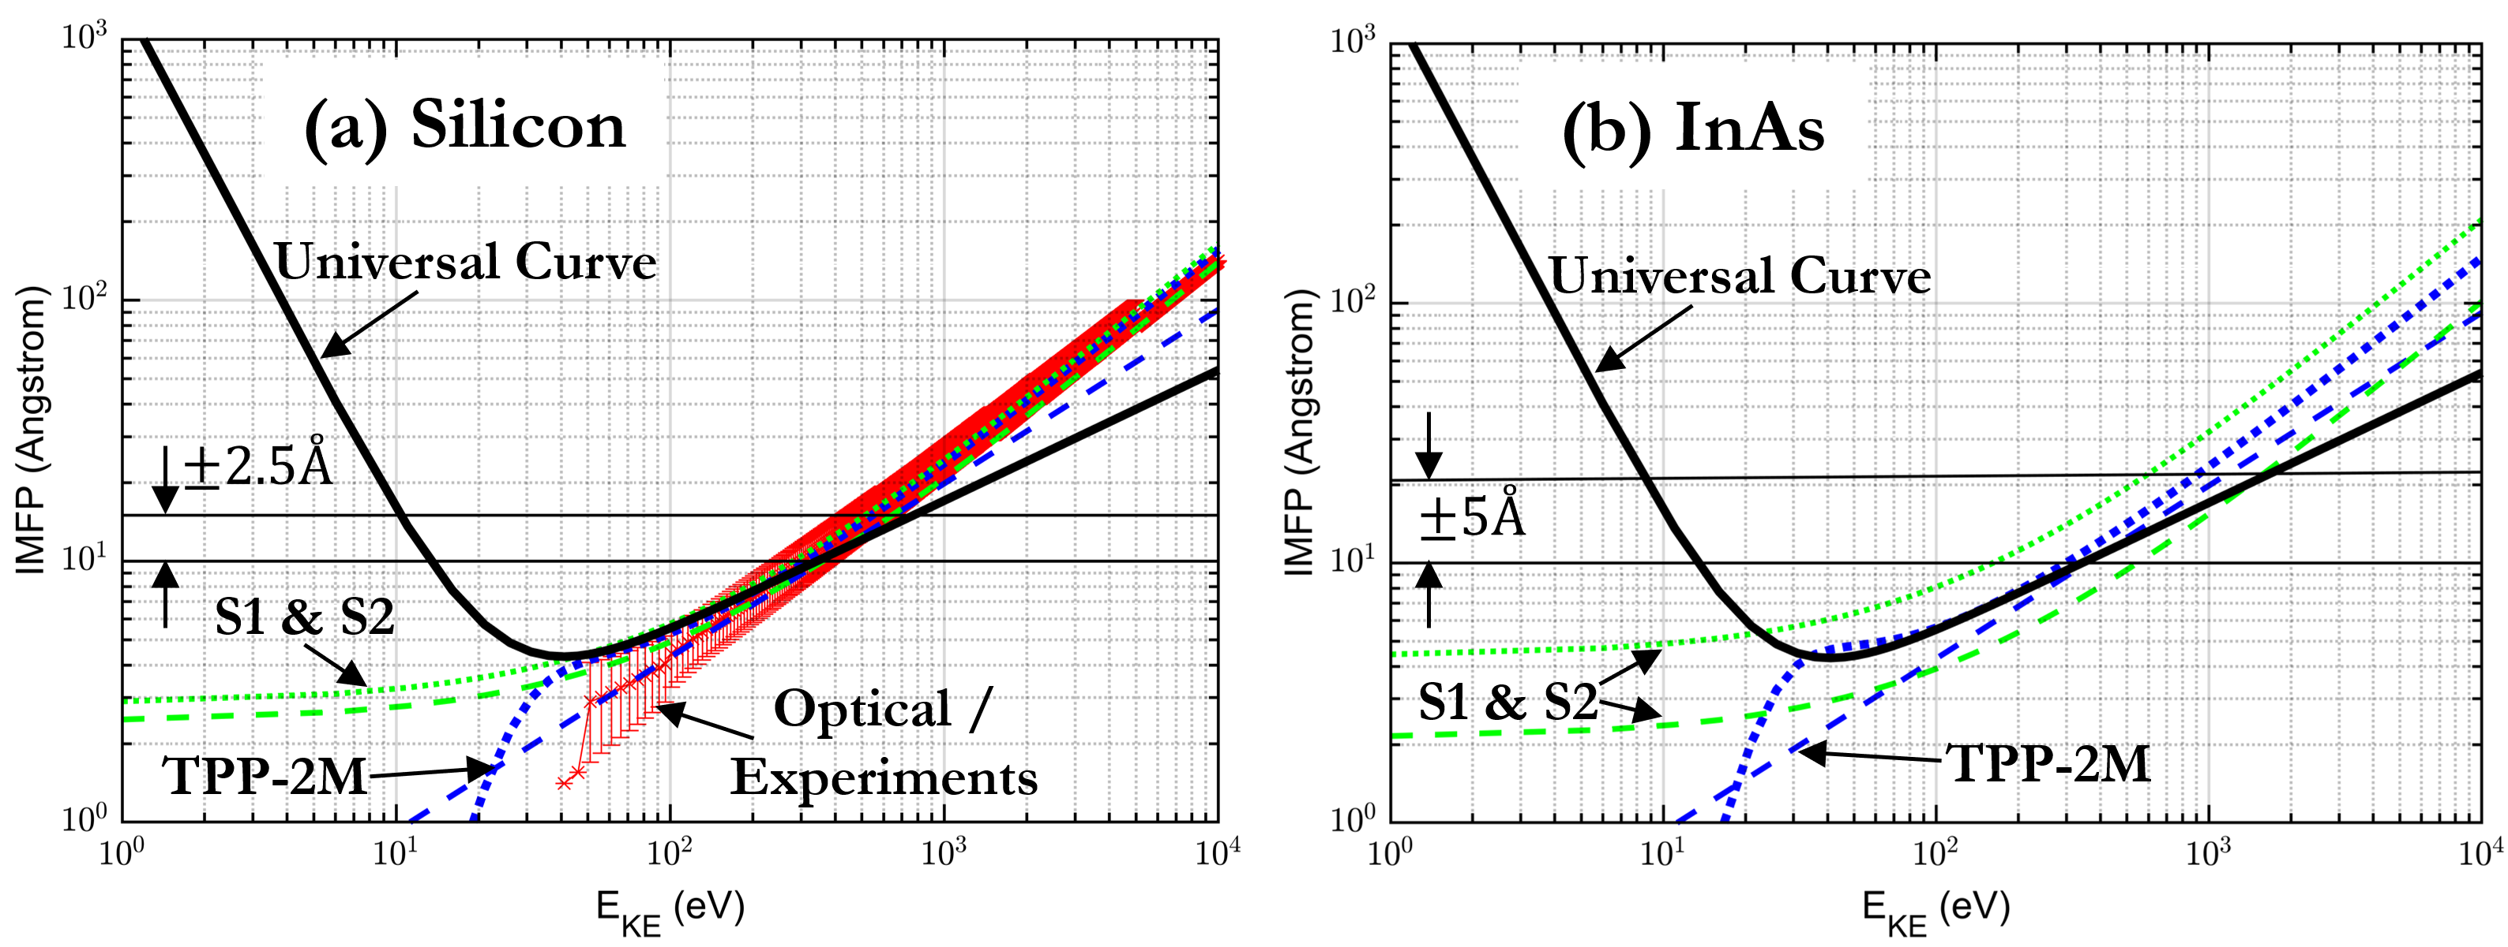
Showcase of the Electron Inelastic Mean Free Path Database
view_eimfp_props("Si");
view_eimfp_props("InAs");
Available electron IMFP calculator functions:
eimfp_optical() *gives all available optical experimental data
eimfp_S1()
eimfp_S1_mpd()
eimfp_S2_avg()
eimfp_tpp2m()
eimfp_tpp2m_avg()
eimfp_tpp2m_mpd() **Recommended IMFP calculator to use
eimfp_universal()
For a particular material:
Use ‘get_eimfp_props()’ to extract all experimental data.
Use ‘view_eimfp_props()’ to quickly view data.

Slide 3
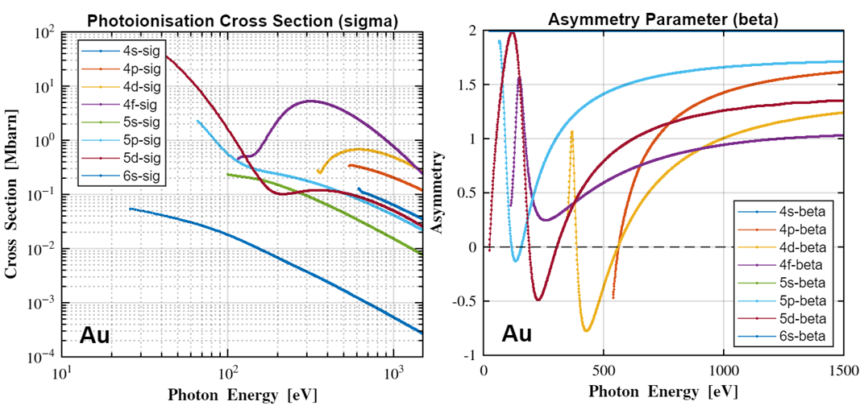
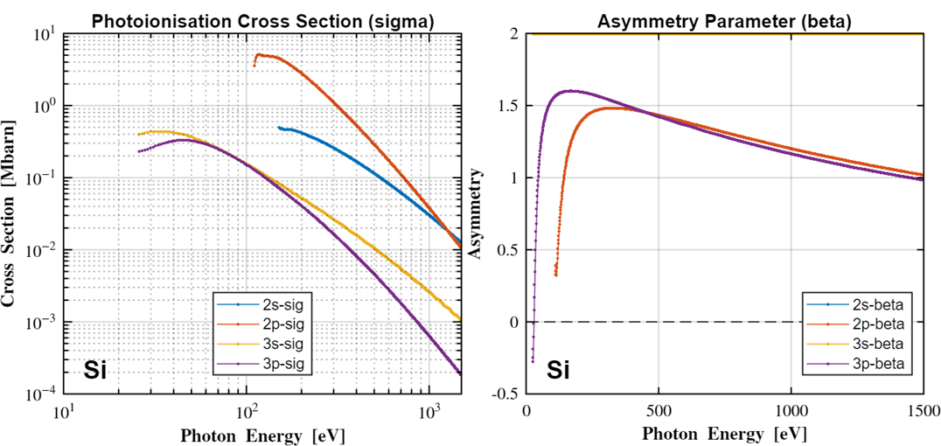
Showcase of the Photoionisation Cross-Section and Asymmetry Database
view_pixsad_props("Au");
Elements 1 – 103 available and use:
‘get_pixsad_props()’ to extract all experimental data.
‘view_pixsad_props()’ to quickly view data.
view_pixsad_props("Si");

Slide 4
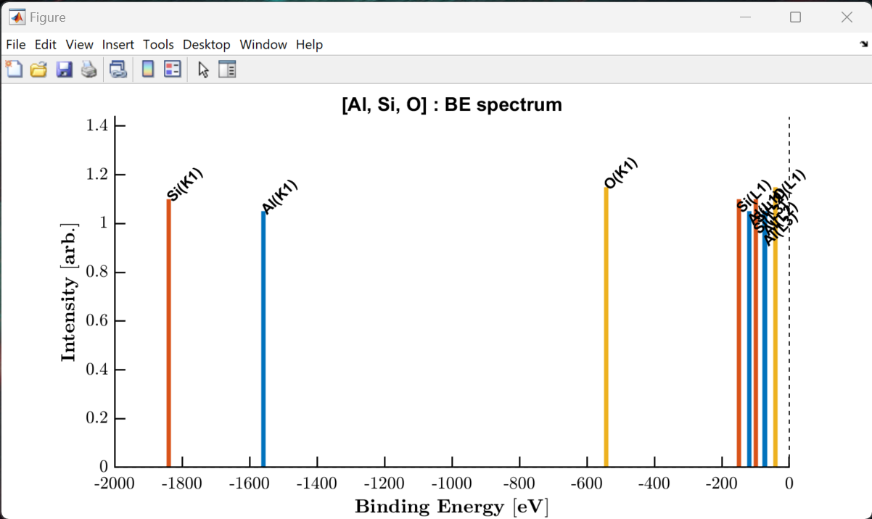
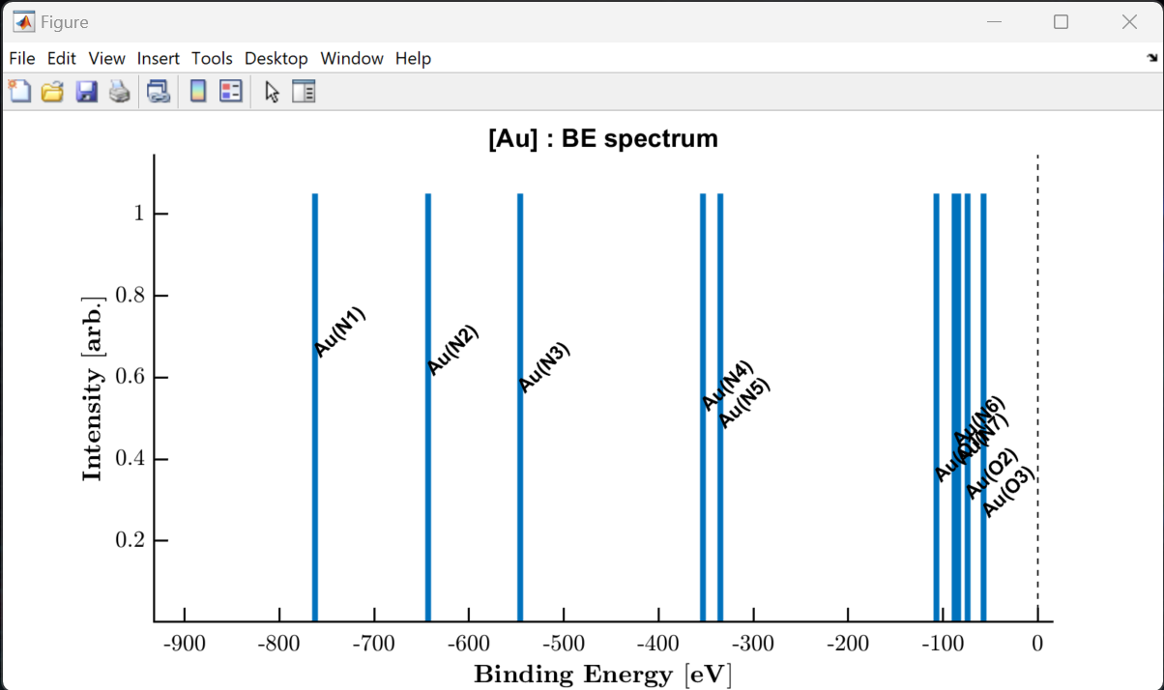
Showcase of the Photoionisation Energy and Fluorescence Database
view_be_spectrum(["Al", "Si", "O"]);
view_be_spectrum("Au");
Elements 1 – 103 available.
‘get_piefd_props()’ to extract all experimental data.
‘view_be_spectrum()’ to quickly view all occupied core-levels.

Slide 5
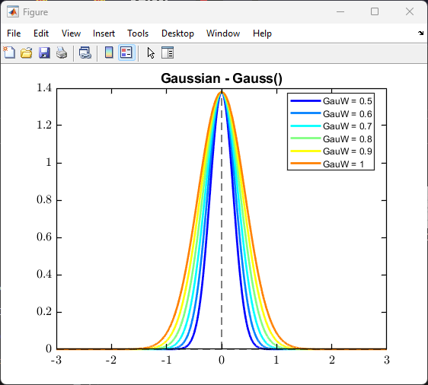
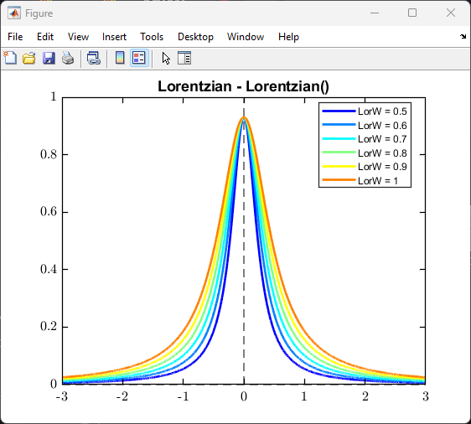
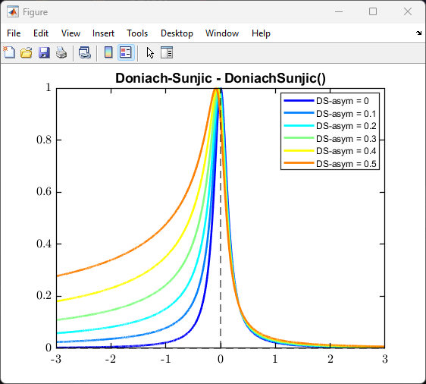
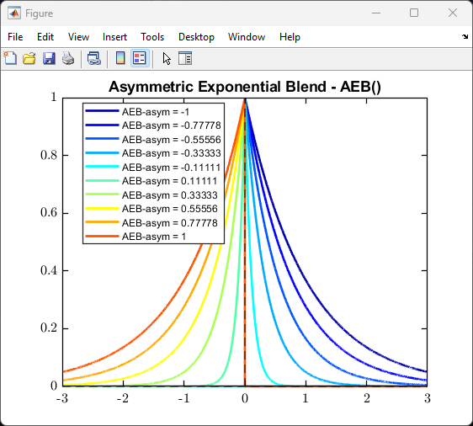
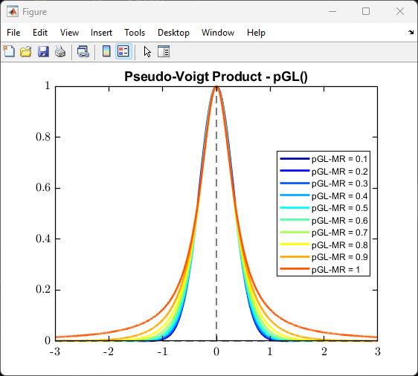
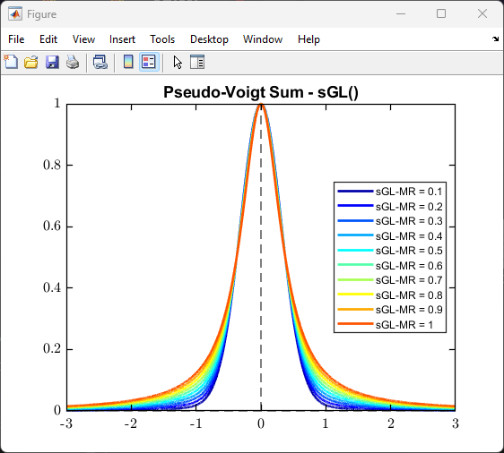
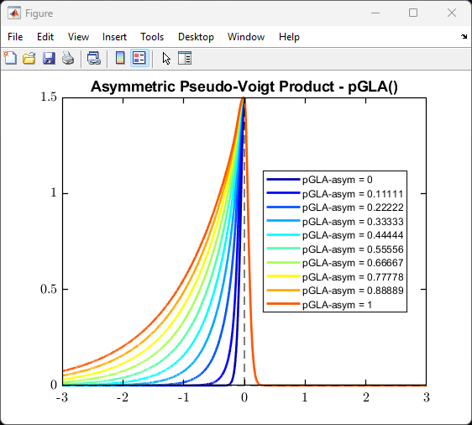
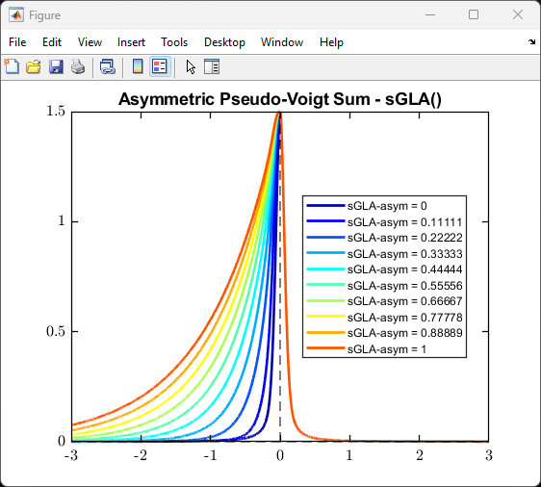
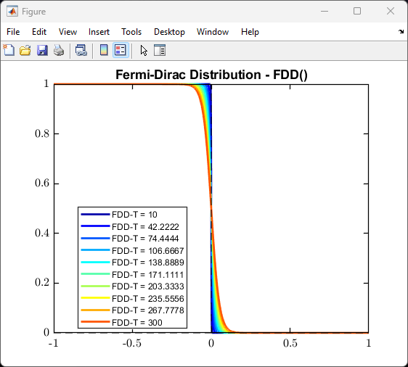
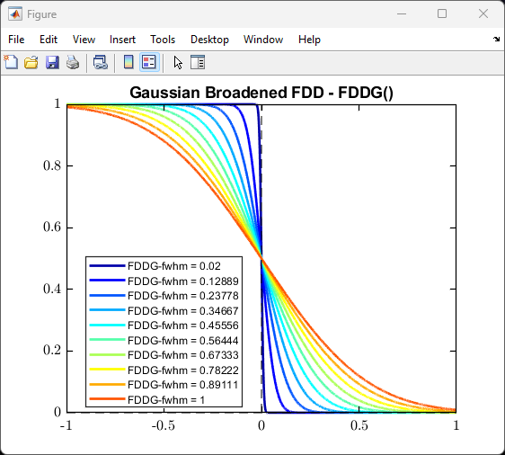
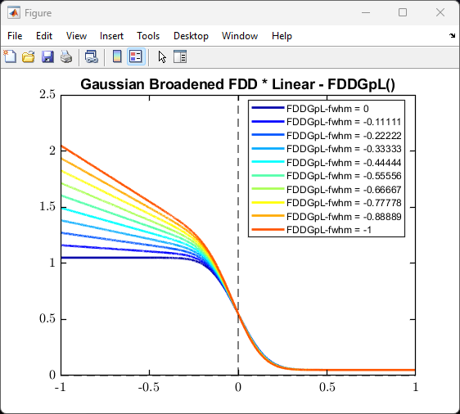
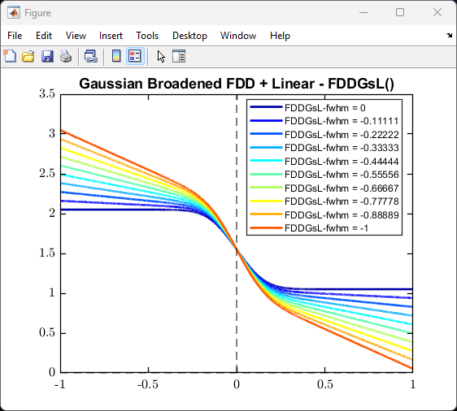
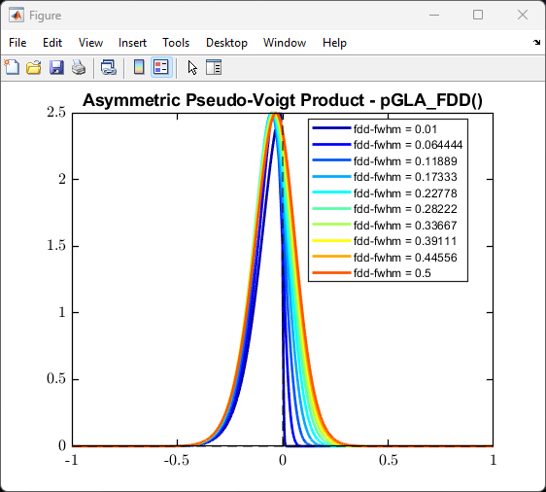
Showcase of the offered fundamental curve shapes

Slide 6
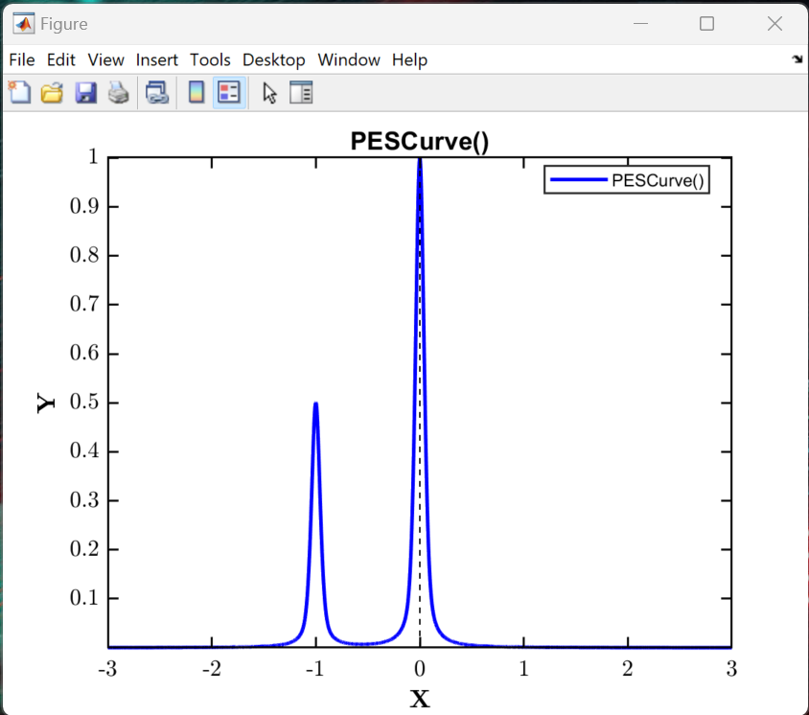
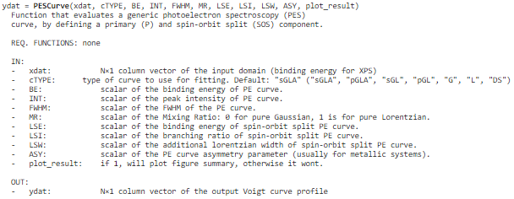
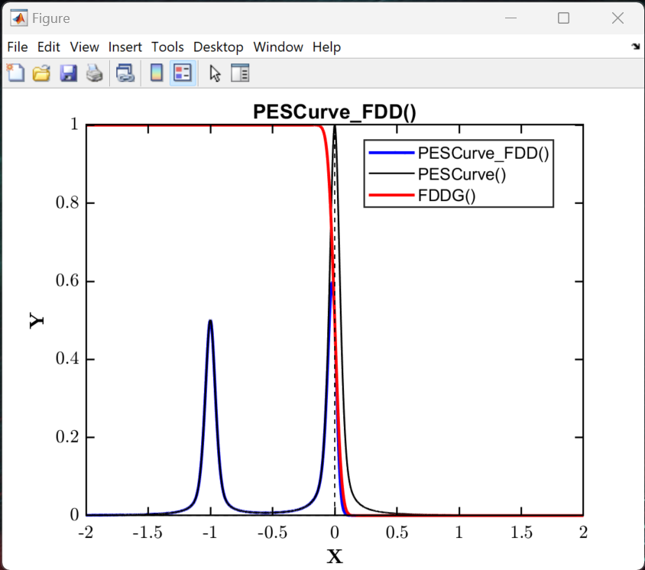
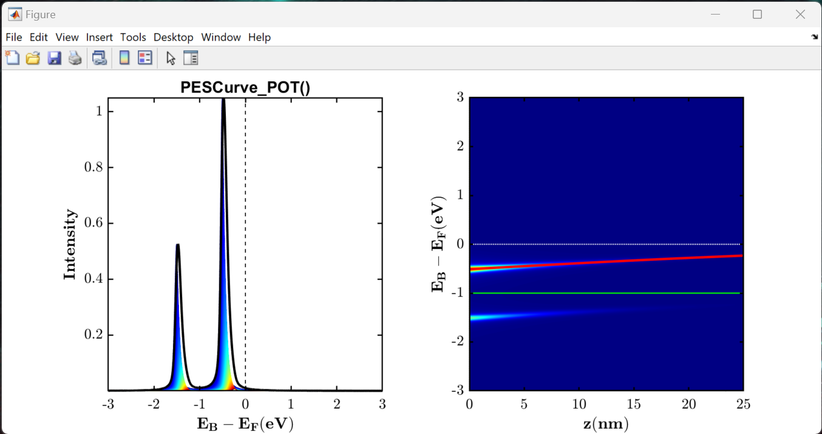
Showcase of the offered PES model curves
Use the PESCurve() function to generate a generalised PES model curve, defining a primary and spin-orbit split component.
A linear combination of these can be used to fit XPS data.
help PESCurve;
See ‘Example_003_PES_Model_Curves.mlx’ Live Script for examples.
PES Curve generated from the layer summation of a potential profile, enveloped over the IMFP.
PES Curve convolved with FDD at Fermi-edge

Slide 7
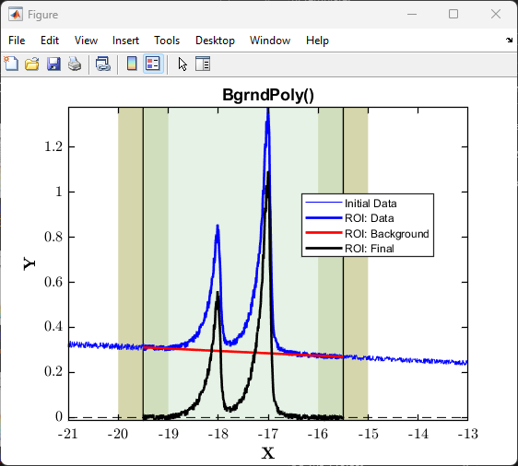
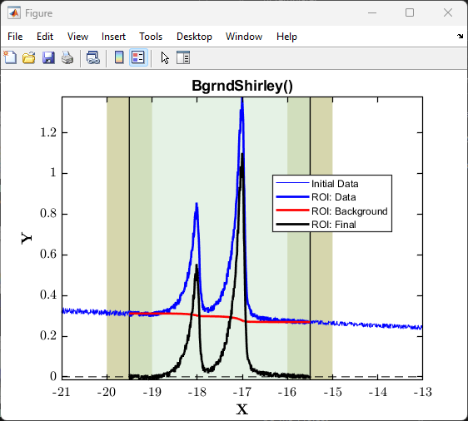

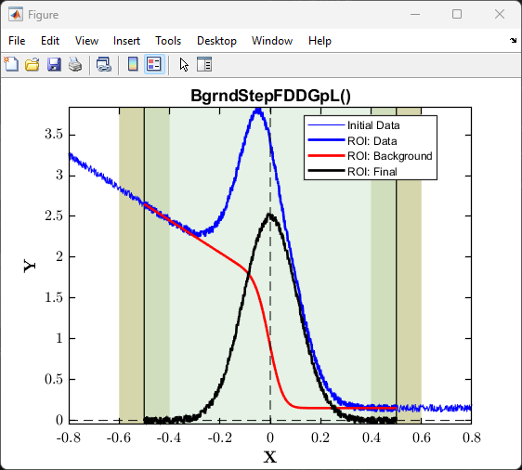
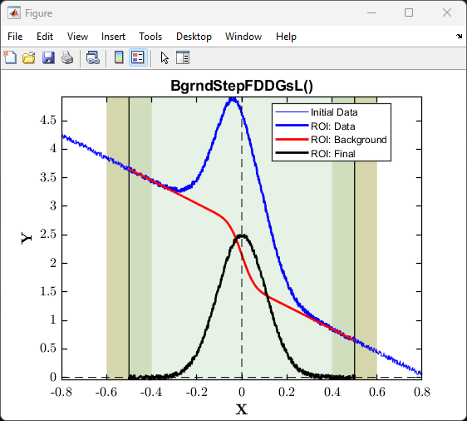
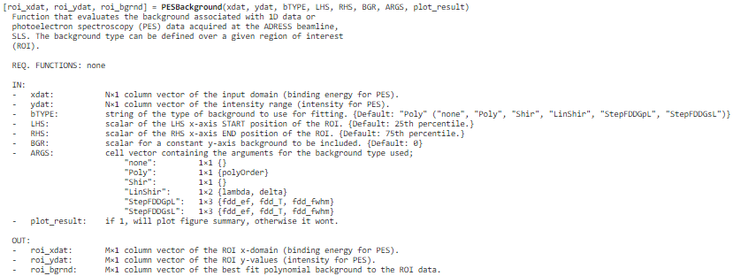
Showcase of the offered PES background curves
Use the PESBackground() function to call any of these background subtraction methods; polynomial, Shirley and linear step functions.
help PESBackground;
See ‘Example_003_PES_Background_Curves.mlx’ Live Script for example on how to use.

Slide 8
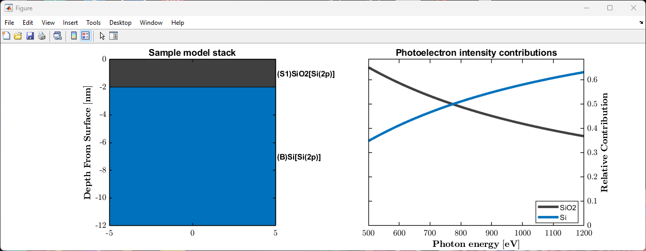
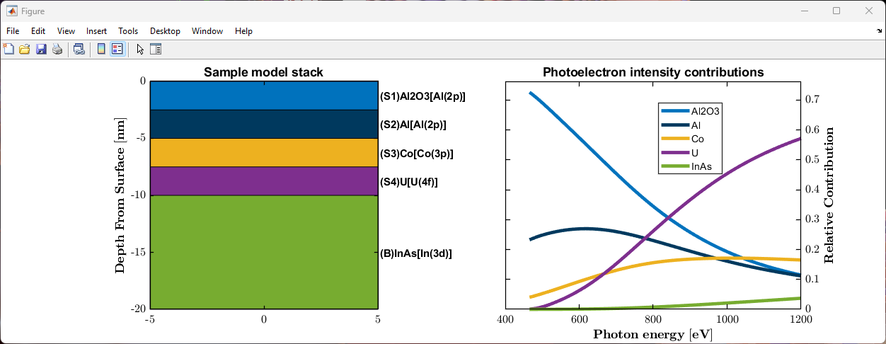
Simulating the photoelectron intensity contributions of an N-layered sample
pes_model_2L = nlayer_pes_model(500:1200, {'SiO2', 'Si'}, {'Si(2p)', 'Si(2p)'}, {2.0, Inf});
Tools can be used to fit the photon energy dependence of PES data.
nlayer_pes_model() function to simulate photoelectron intensity contributions of an N-layer model.
view_nlayer_pes_model() to quickly view solved model.
view_nlayer_sample() to quickly view the defined N-layer model sample stack.
overlayer_calc() to determine thickness of an overlayer on a bulk substrate using PES.
See ‘Example_020_Multilayer_PES_Modelling.mlx’ Live Script for example on how to use.

Slide 9
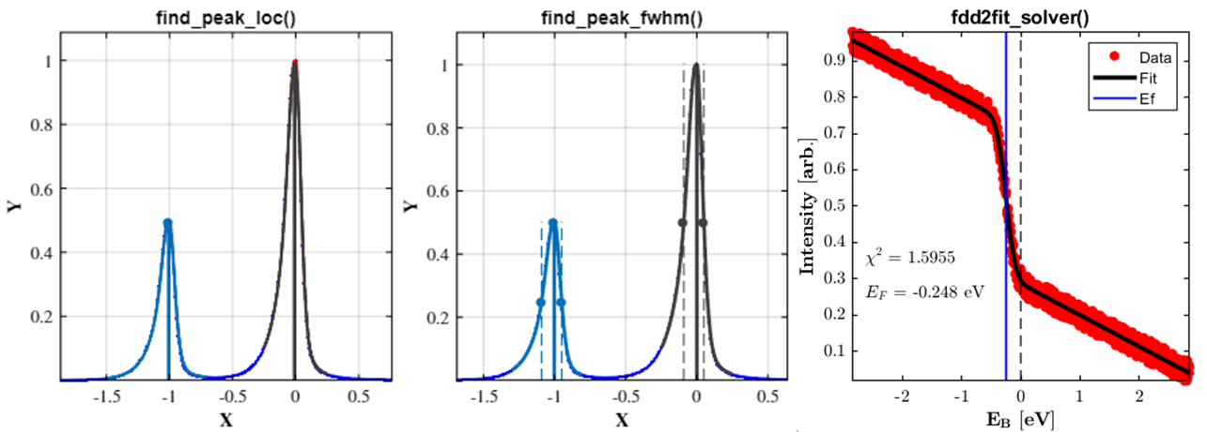
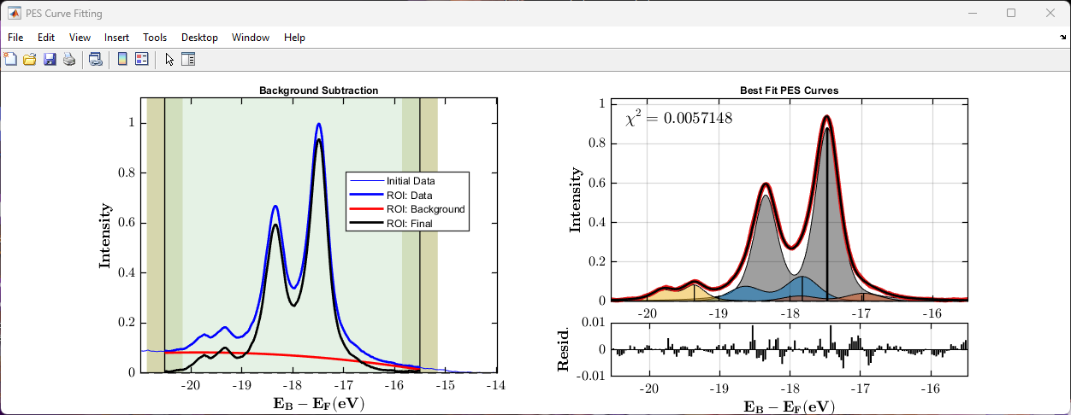
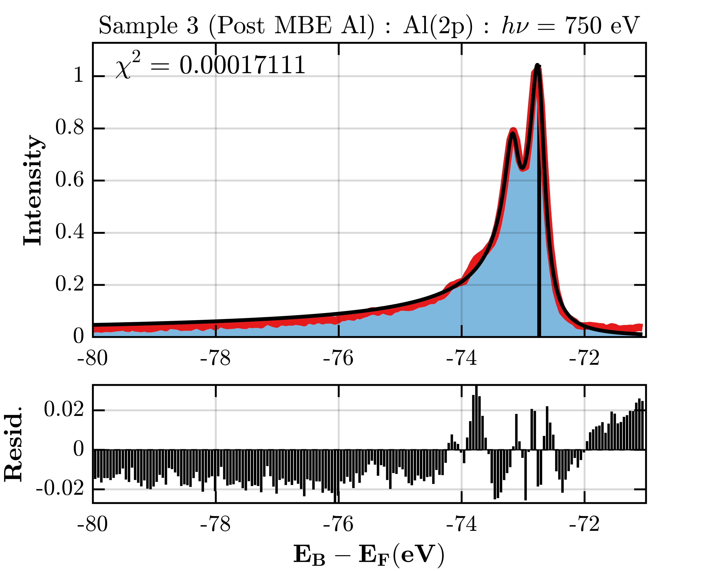
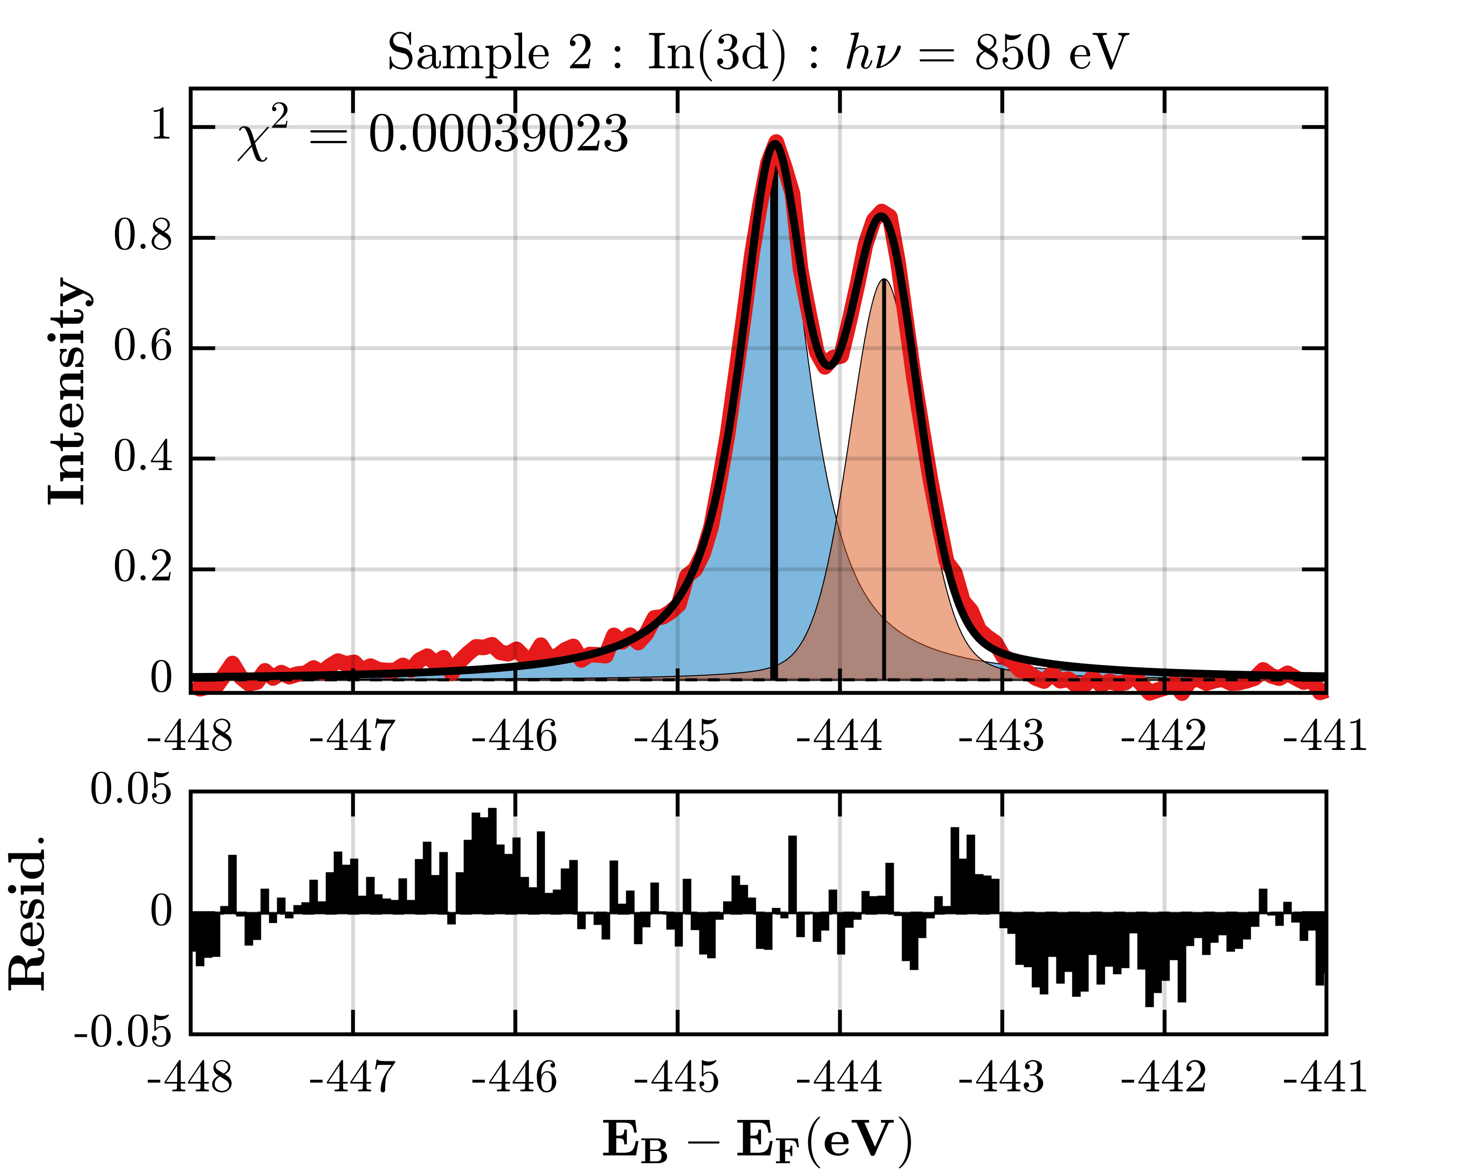
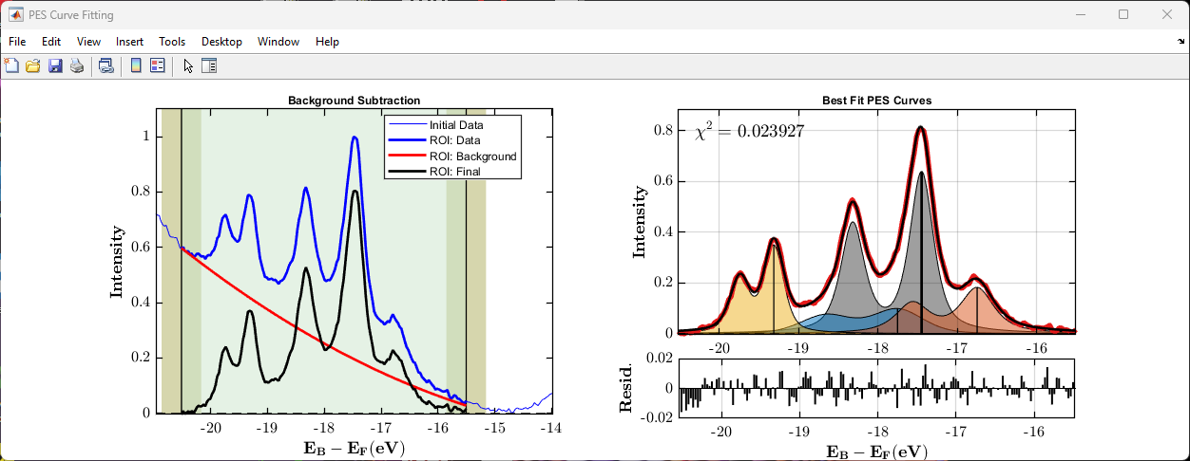
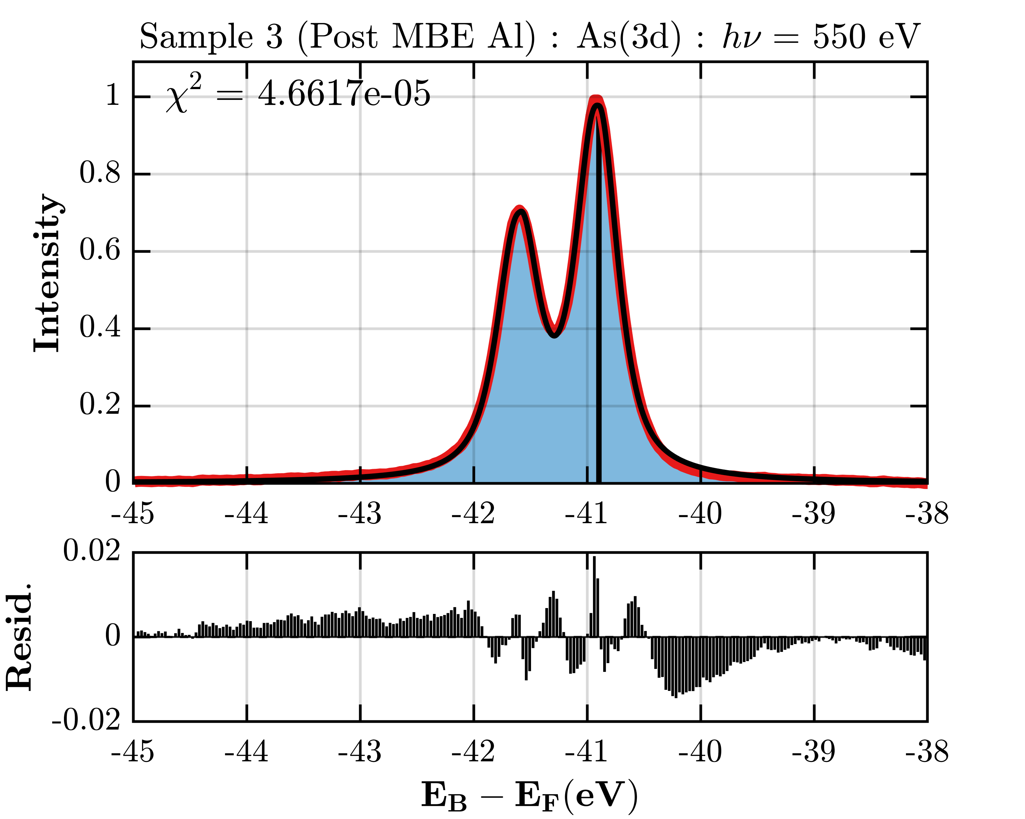
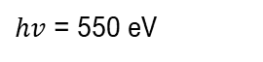
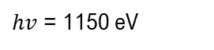
Showcase of curve fitting photoelectron spectroscopy data
Peak location finder
In(4d)
Al(2p)
$hv$ = 550 eV
Peak FWHM finder
In(3d)
In(4d)
$hv$ = 1150 eV
As(3d)
Fitting FDD for EB reference
See ‘Example_021-022_PES_Data_Fitting.mlx’ Live Script for an example on how to run the PES fitting routines.

Slide 10
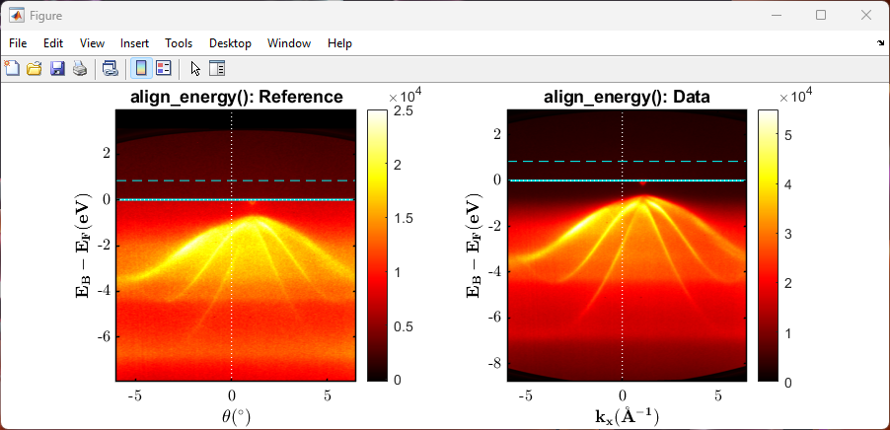
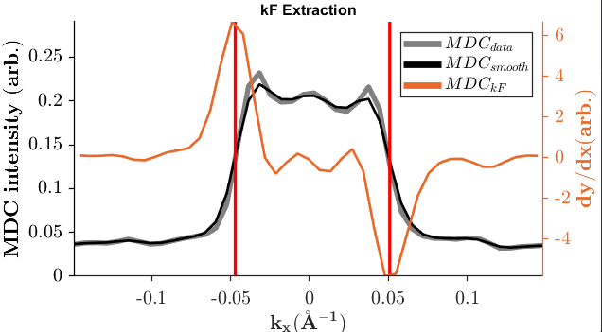
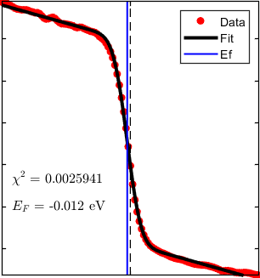
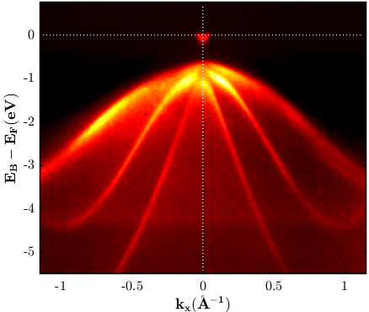
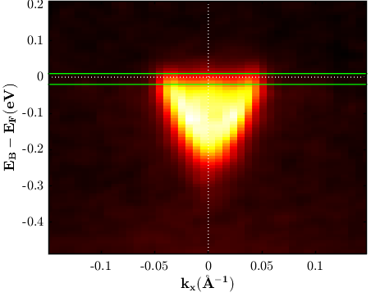
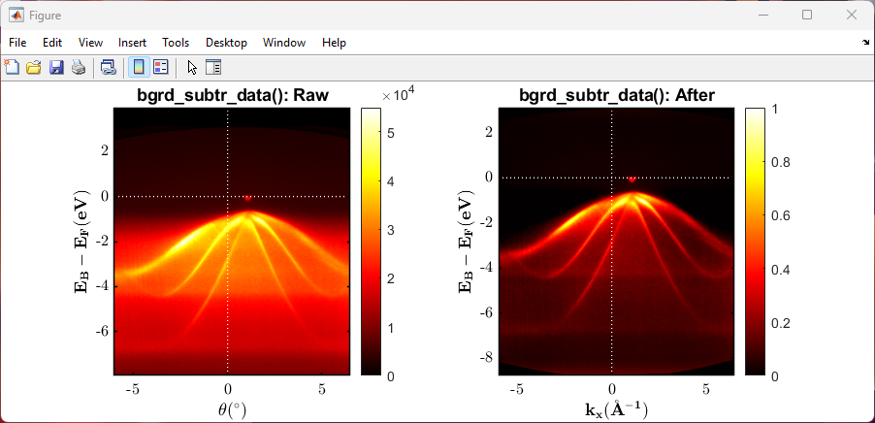
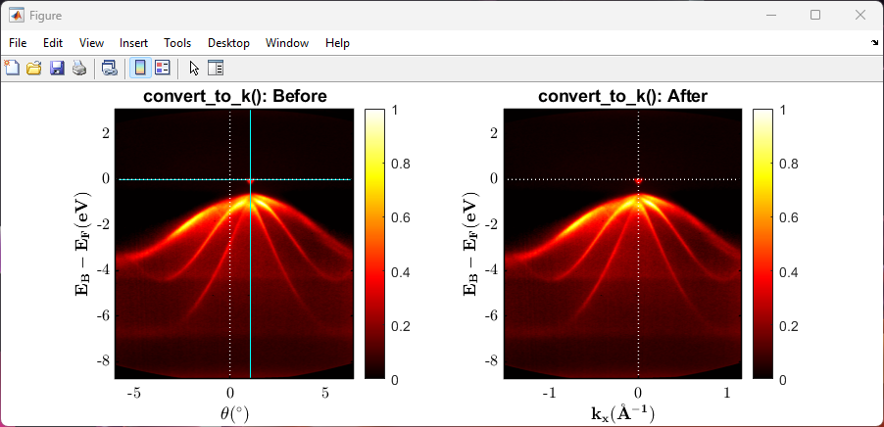
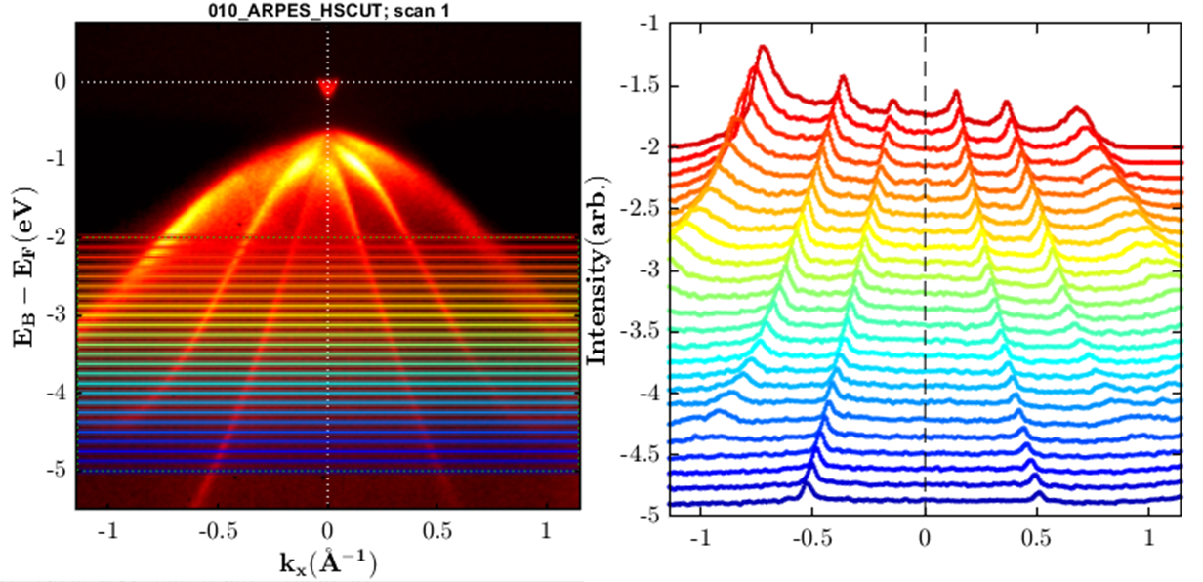

Showcase of the offered ARPES data processing tools
(1) Eb alignment
Final ARPES data after processing
(2) Background subtraction
Kf extraction using maximum gradient method
(3) Angle$→$Wavevectors
MDC Cut Series
See ‘Example_010-012_ARPES_EbKx_Processing.mlx’ Live Script on a step-by-step guide to process ARPES data.

Slide 11
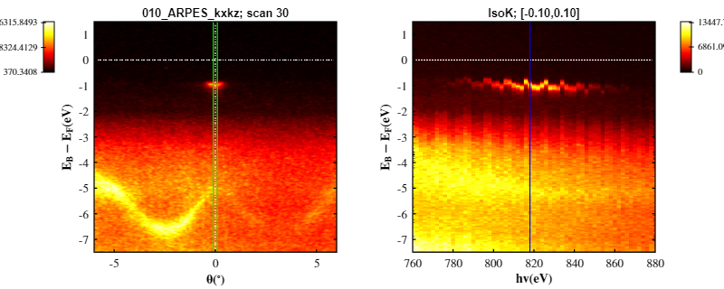
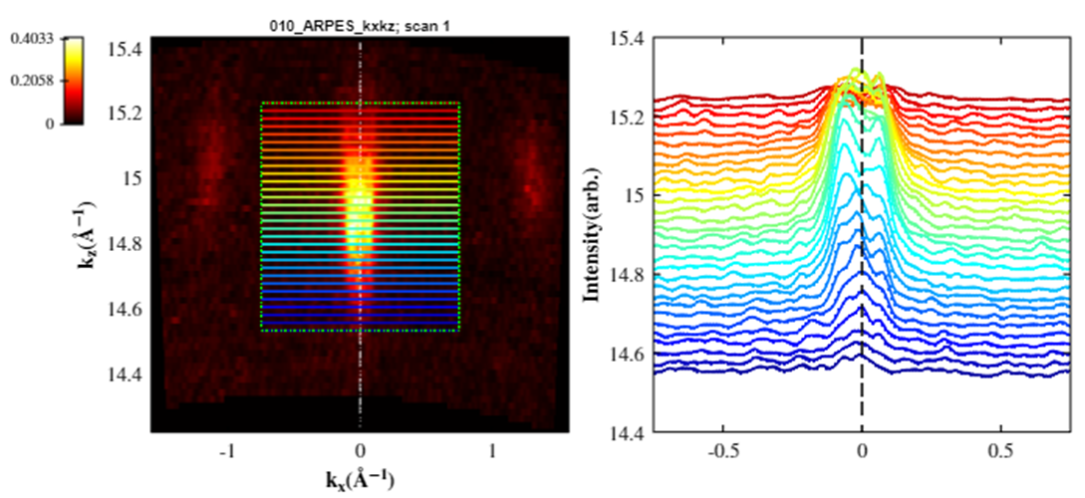
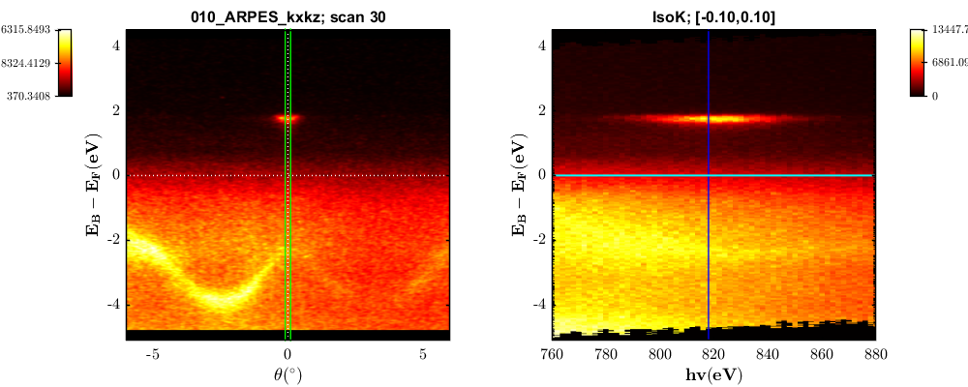
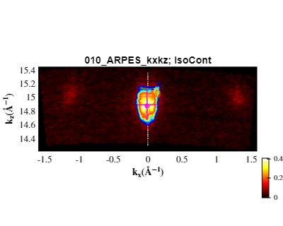




Showcase of curve fitting ARPES data
(1) 3D ARPES data
MDC Cut Series of IsoE Slice
(2) Eb alignment
Extracting electron pocket properties
(3) Angle$→$Wavevectors
IsoK Slicing
IsoE Slice with BZ overlay
IsoE Slicing
See ‘Example_010-012_ARPES_KxKz_Branched_Processing.mlx’ Live Script for another example.

Slide 12









Showcase of the offered ARPES model curves
3 subbands example
See ‘Example_003_ARPES_Model_Curves.mlx’ Live Script for example on how to use.

Slide 13




Showcase of curve fitting ARPES data
Fit VB to Leading Edge
Fit VB to Leading Peak
-0.773 eV
-0.564 eV
Fit CB to N-Parabolas
MODEL
DATA
See ‘Example_013_ARPES_EbKx_Fitting.mlx’ Live Script for an example on how to run the ARPES fitting routines.

Slide 14



Brillouin Zone Navigation: Relating photon energy to $k_{z}$
extract_lattice()
HX-ARPES regime
2000 – 6000 eV
extract_bz_overlay()
SX-ARPES regime 310 – 1600 eV
UV-ARPES regime 10 – 200 eV
See ‘Example_002_BZ_Navigation.mlx’ Live Script for an example.
extract_hv_overlay()

